Slide 1
FELIX and NSI: Mutual Authentication and Authorization (Work in progress)
Presenter: Umar Toseef
OGF 43, Washington
26 March 2015

Slide 2
Contents
FELIX background information
Authorization NSI
Proposed solution
Summary

Slide 3
FELIX Background Information

Slide 4



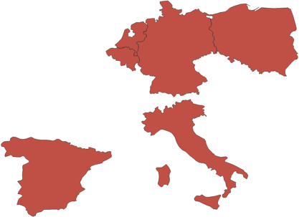
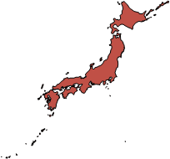




FELIX in a nutshell [1]
Facts
Objectives
EC (EU), MIC & NICT (JP) collaborative project
Collaboration between European and Japanese partners
Started in April 2013. To run till March 2016
To createa large-scale testbed (experimental infrastructure), federated across two continents
To define a common software architecture for testbeds
EU coordinator
JP coordinator
NL
PL
BE
DE
JP
IT
ES

Slide 5
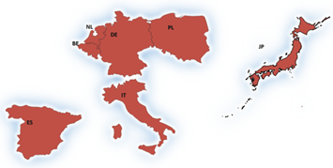





FELIX in a nutshell [2]
Existing testbeds
OFELIA (OpenFlow in Europe: Linking Infrastructure and Applications)
www.fp7-ofelia.eu
RISE (Research Infrastructure for large-Scale network Experiments)
www.jgn.nict.go.jp/rise/english
Why to federate?
To increase mutual benefits of European and Japanese researchers by creating more complex environments for specialized research and experiments
Notes:
First large-scale OpenFlow-enabled experimental facility in Europe), continuously evolving through other FIRE projects (FIBRE, Fed4FIRE, ALIEN, etc.)
OpenFlow testbed over JGN-X (the largest testbed network in Japan), with wide-area coverage from US West coast to Southeast Asia
This opens up new opportunities for experiments due to geographical dispersion of testbeds
By federating SDN islands, an integrated infrastructure can be constructed over globally distributed resources

Slide 6
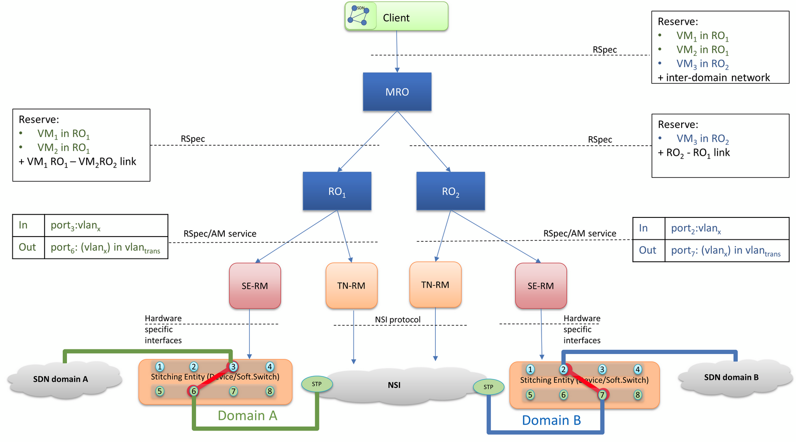
Inter-domain networking through NSI
RO: Resource Orchestrator, MRO: Master RO, VM: Virtual Machine, AM: Aggregate Manager,
RM: Resource Manager, SE-RM: Stitching Entity-RM, TN-RM: Transit Network-RM

Slide 7
FELIX Clearinghouse
A trust anchor and responsible for authentication and authorization of all actors in a FELIX deployment
Supports extended Common Federation Service API version 2
Authentication using digital certificate
Certificate
Asserts: public key ↔ subject
Issued & digitally signed by clearinghouse CA
Defined validity period
X.509 version 3
Authorization using digital credentials
Credentials
Provide the owner with permissions on a target object
Issued & digitally signed by clearinghouse CA
Defined validity period
Can be delegated
SFA and ABAC formats are supported

Slide 8
Authorization in NSI

Slide 9
Authorization in NSI
NSI is agnostic to authentication and authorization methods used by any network deployment
NSI introduces a flexible <sessionSecurityAttr> header element for transporting security related information between NSAs within the trusted control plane
The format of the any security related parameters inside the <sessionSecurityAttr> is left up to solution implementation
<sessionSecurityAttr> must be supplied by user/application to uRA for insertion in NSI request header
Security attributes are securely transported to all uPA involved in the reservation and consumed by their Authorization Server(s)
SURFnet deployment has employed OAuth token based authorization

Slide 10
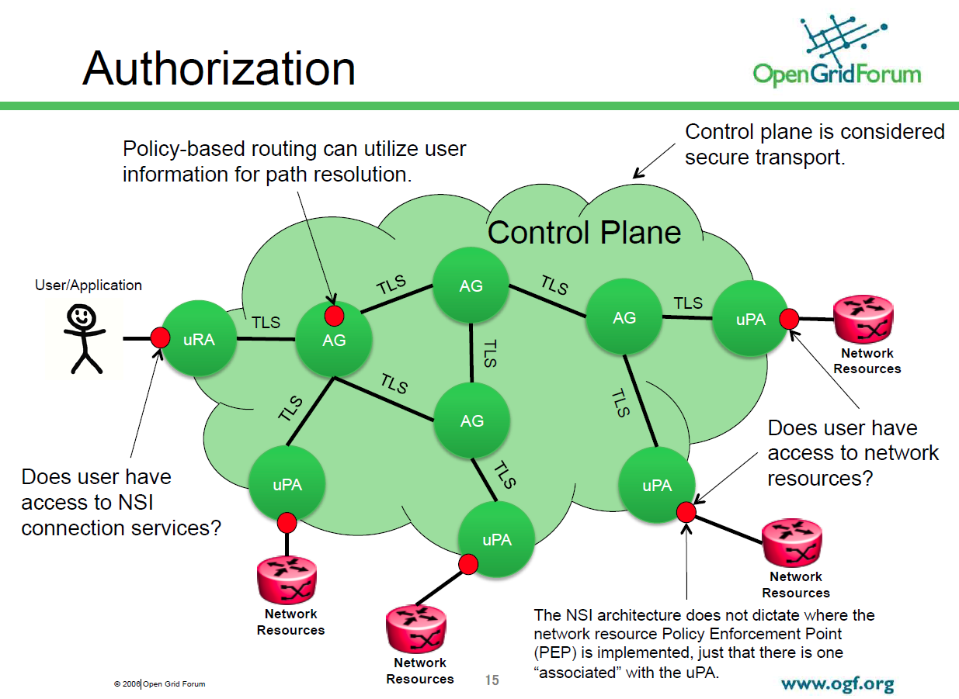
A depiction…
* Copied from John MacAuley’s presentation on NSI: Security Omnibus, Dec. 2014

Slide 11



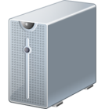
OAuth: Abstract protocol flow
User
(Resource owner)
0. User Registration
Authorization Server
Application
(client)
1. Authorization Request
User
(Resource owner)
2. Authorization Grant
3. Authorization Grant
Authorization Server
4. Access Token
5. Access Token
Resource Server
6. Requested resources
*Figure redrawn from RFC 6749

Slide 12
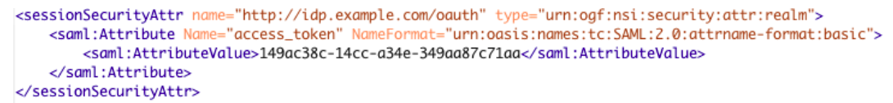
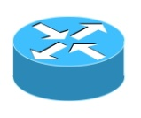
Authorization in NSI using OAuth
1. Auth Grant
Authorization Server
2. Access token
3. Access token + NSI
reservation request
uRA
Secure
Transport
4a. Access token
placed in NSI header
AG
6. Validate access token
4b. Access token
placed in NSI header
uPA
NRM
5. Extract access token
7. Confirm reservation

Slide 13
OAuth-based Solution for FELIX

Slide 14
Trust between FELIX and NSI
Assumption: A central NSI Authorization Server exists per NSI deployment
Establish trust relationship between FELIX clearinghouse and NSI Authorization Server (analogous to user registration)
NSI Authorization Server adds FELIX clearinghouse’s root certificate in its Trusted Root Certificates
This way, NSI Authorization Server recognizes all certificates and credentials signed by FELIX clearinghouse
TN-RM obtains GENI styled digitally signed credentials by FELIX clearinghouse
TN-RM employs its credentials as ‘Authorization Grant’ to authenticate and authorize with NSI Authorization Server and obtain access token

Slide 15

OAuth: Abstract protocol flow
FELIX
TN-RM
FELIX Clearinghouse
Digital credential
Trust
Digital credential
NSI
Authorization Server
Access Token
Access Token
NSI
AG/uPA
Requested resources

Slide 16
FELIX and NSI: Authentication and Authorization
RO
MRO
NSI Authorization Server
1. Credential
TN-RM
Credential
FELIX Clearinghouse
2. Access token
Secure
Transport
3. Access token placed
in NSI request header
AG
6. Validate access token
4. Access token placed
in NSI request header
uPA
NRM
5. Extract access token
RO: Resource Orchestrator
MRO: Master RO
RM: Resource Manager
TN-RM: Transit Network-RM
7. Confirm reservation
Notes:
TN-RM acts as uRA

Slide 17
Important aspects of the proposed solution
Use of FELIX credential as ‘Authorization Grant’ complies with RFC 6749
NSI Authorization Server must NOT issue access token with validity period greater than that of TN-RM’s FELIX credential
In authorization process, NSI Authorization Server must validate presented credential and check whether privileges are sufficient to demand an access token
TN-RM’s FELIX credentials are issued and renewed by FELIX clearinghouse
TN-RM may use same access token for multiple resource requests
TN-RM may request access token more than once using the same credentials
The proposed approach could also be employed by other GENI/FIRE SDN testbeds

Slide 18
Summary
FELIX project is about federation of SDN testbeds in EU and Japan
FELIX relies on NSI for multi-domain on-demand network connection services through transit network
OAuth can be used for NSI control-plane authentication and authorization
NSI Authorization Server establishes trust relationship with FELIX clearinghouse
TN-RM entity of FELIX acts as uRA when interfacing NSI world
FELIX clearinghouse issues GENI styled credential to its TN-RM entity
TN-RM exchanges its FELIX credentials to obtain access token
In future other methods for AuthN/AuthZ may also be supported

Slide 19
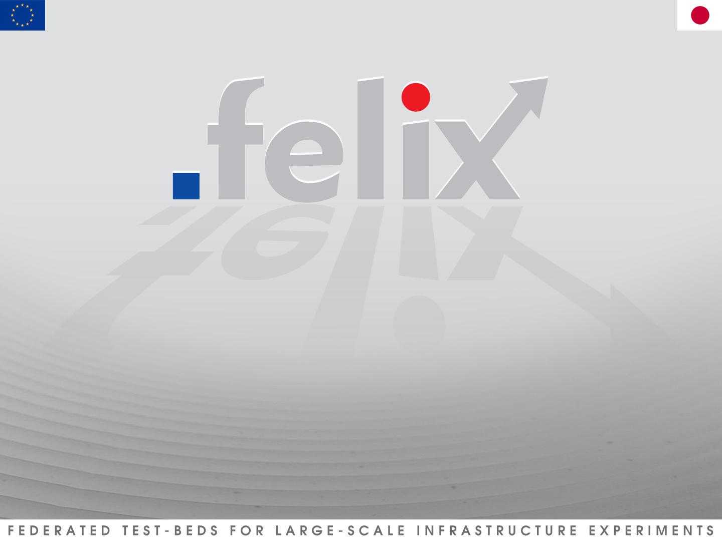
Thanks for your attention
Acknowledgement:
Some figures and text are based on John MacAuley’s presentation on NSI: Security Omnibus, Dec. 2014

